Slide 1


Supply Chain Analytics
Maersk Supply Chain Optimization Rohan Giri MS in Business Analytics

Slide 2
Just in Time
01
Briefing Recap
Business performance
Customer and Product
Inventory management
Agenda
02
Business Intelligence Analysis
Business downturn
Overstock and understock
Delay shipment
03
Proposal

Slide 3
Just in Time
01
Briefing Recap

Slide 4
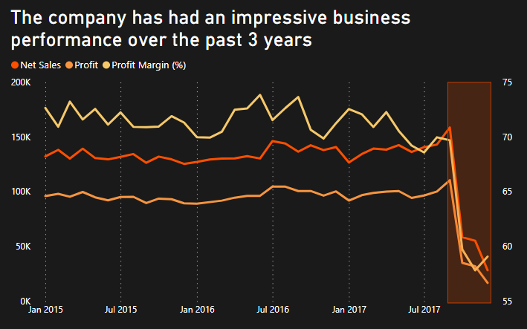
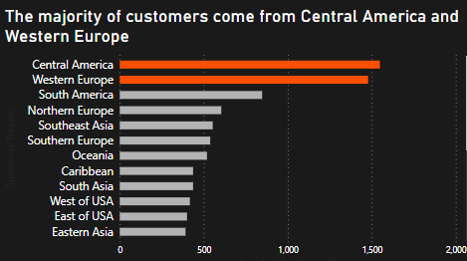
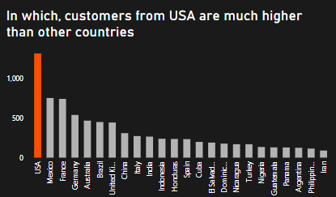
1. Business performance
2. Customer
However, both net sales and profit dropped sharply in Q4/2017

Slide 5
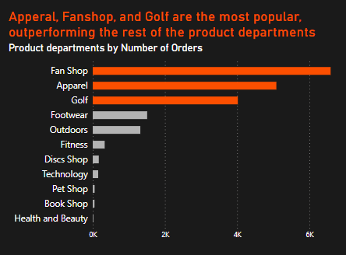
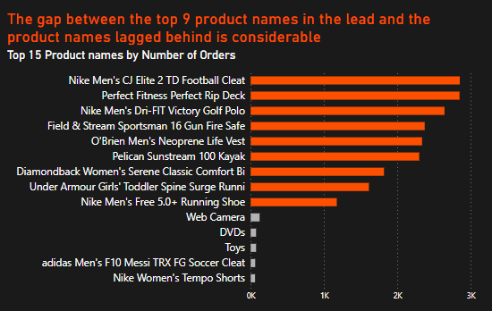
3. Product
These three departments alone account for more than 70% of orders
There are no product names out of the top 9 could reach 1000 orders

Slide 6
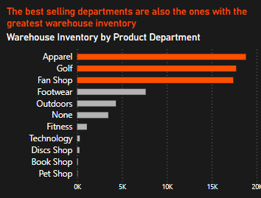
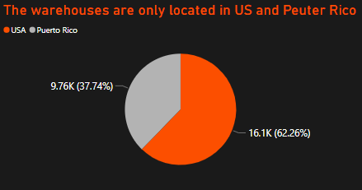
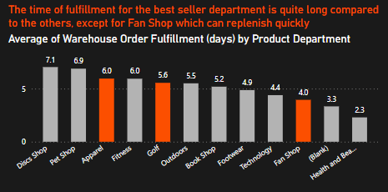
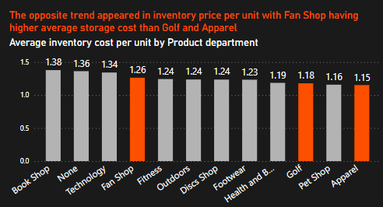
4. Inventory
In which, most of the orders are shipped from the US

Slide 7
Just in Time
02
Business Intelligence Analysis

Slide 8
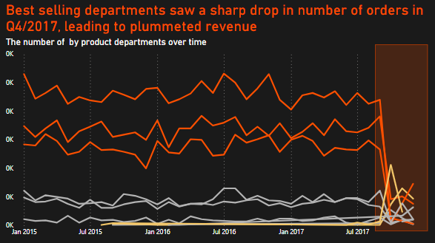
1. Business downturn
Apparel, Fanshop, Footwear and Golf which were instrumental to business’s success has suddenly plummeted and almost disappeared.
Meanwhile, the product departments such as Technology and Discs Shop showed potential growth
The absence of the old leading - best selling departments (Apparel, Fanshop, Footwear, Golf), was closely linked to this downturn.

Slide 9
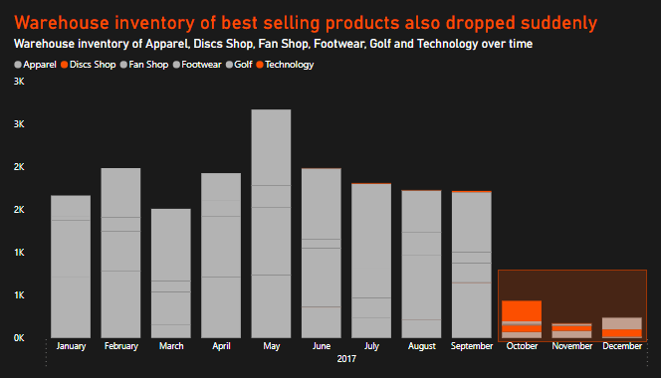
1. Business downturn
Inventories of Apparel, Fanshop, Footwear and Golf almost disappeared even though there was no sign of a sharp decrease before.
New departments like Technology suddenly had an increase in inventory follow by a gradual decrease
This decline was not due to changing customer preferences, but rather a supply chain disruption from supplier network

Slide 10
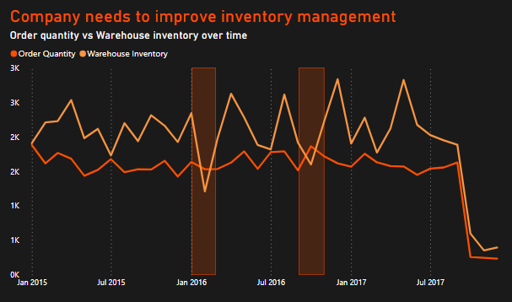
2. Inventory management
The company is frequently having excessive inventory or overstocked
Inventory fluctuates strongly at times, even though customers’ demand is quite stable
The company is facing the challenge of not being able to maintain a stable warehouse inventory to meet the ordering demand of customers

Slide 11
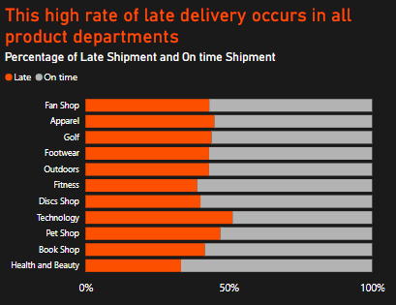
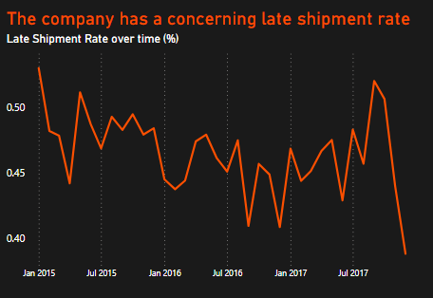
3. Delay shipment
Most product departments have LSRs around the 40% mark, except for technology whose rates go up to more than 50%.
LSR range from 40% to 50%
The high late shipment rate of average 40% over a long time which remains concerning and indicates inefficiencies in the shipping system that need improvement

Slide 12
The company is facing three main supply chain issues that need to be addressed
Supplier network disruption
Ineffective inventory management
Overstock and understock
Supply chain inefficiencies
Ineffective shipment system
High late
shipment rate

Slide 13
Just in Time
03
Proposal

Slide 14
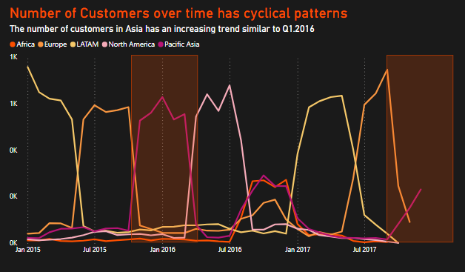
1. Supplier disruption
In short term, the company should focus on suppliers in the likely growing customer group in Asia, especially those that provide emerging product departments such as technology.
In the long term, the next main customer group is likely to be from North America, the company needs to take advantage of the time to redesign the supplier network to recalling old best selling departments
Over time, the tendency to join shopping online rise sharply in the LATAM, then in turn to Europe, Pacific Asia, North America and Africa. This trend continues to repeat from the LATAM

Slide 15
2. Inventory management
Call to action |  | Objective
Forecasting demand | - Analyzing historical sales data - Tracking market trends - Employing predictive analytics | Anticipate future demand, allowing to maintain an optimal inventory level.
Setting up controlling indicators for each product | - Reorder points - Lead time - Sales velocity - Desired safety stock levels | Ensuring the company replenishes stock in a timely manner without risking overstocking
Predicting the product life cycle for each region (if possible) |  | Calculate the appropriate amount of inventory and chose the right product for each market

Slide 16
3. Delay shipment
Call to action |  | Objective
The markets near the warehouse (North America, LATAM, Western Europe,...) | - Redesigned transportation route - Adopting a cross-docking strategy - Take advantage of Less - than - truckload transportation | - Reduce the turnaround time - Reduce shipping time
The markets far away from the warehouse (Asia Pacific, SEA,...) | - Establishing a warehouse in a strategic logistics hub like Singapore in Asia | - Expand the company's control on global reach - Reduce the turnaround time - Reduce the shipping time to those markets
Both | - Collaboration with local logistics companies | - Leverage their local existing resources and expertise to optimize cost and supply chain

Slide 17

Thank you

